Slide 1
Effectiveness of a Yoga-based Cardiac Rehabilitation (Yoga-CaRe) Program: A Multi-centre Randomised Controlled Trial of Patients With Acute Myocardial Infarction From India Dorairaj Prabhakaran MD, DM Executive Director, CCDC & Vice-President, PHFI Late breaking Clinical trials – AHA ’18
Embargoed Until Saturday Nov. 10, 3:45 pm CT, 4:45 pm ET
Funding: Indian Council for Medical Research (India) &Medical Research Council (UK)
Yoga-CaRe Trial Investigators

Slide 2
Yoga-CaRe Trial – The Rationale
Cardiac Rehabilitation (CR) is a Class I indication in post MI patients and has become an integral part of cardiac care in High Income Countries.
CR is virtually non-existent in Low-Middle Income Countries due to its high cost and the need for a multidisciplinary team.
Even In high income countries uptake of CR is 25-35% and is particularly poor among the elderly and women who may prefer gentler and simpler approaches.
High unmet need for CR.
In India, need for developing a low-cost, culturally acceptable and effective cardiac rehabilitation, a need that would be filled by Yoga-CaRe should it prove to be efficacious.

Slide 3
Why Yoga ?
Cardiac Rehabilitation
Yoga
Stress Reduction: Counselling/ medication for depression
Stress reduction : breath control and meditation
Physical fitness: Yogic postures
Physical fitness: Exercise
Lifestyle changes: Smoking cessation, Nutrition counselling and other healthy behaviors
Lifestyle changes : Self-restraint (smoking, alcohol) , Healthy diet

Slide 4
Aims
Outcomes
Primary Outcomes
Time to occurrence of first cardiac event (composite of death, nonfatal myocardial infarction and stroke) & emergency cardiac admissions
Quality of life (EQ-5D-5L) at 12 weeks
Secondary Outcomes
Return to pre-infarct daily activities at 12 weeks (RNLI)
Smoking cessation at 12 weeks
Compliance to prescribed medications at 12 weeks
To compare the effectiveness of Yoga based Cardiac Rehabilitation (Yoga- CaRe), with Enhanced Standard Care (ESC) in post myocardial infarction patients on cardiac morbidity and mortality and quality of life.

Slide 5
Methods
Study sites : 24 centers in India
Study design: PROBE
Trial duration: 50 Months (Aug’14-Sept’18)
Sample size – 3959 Participants
80% power to detect 20% reduction in cardiovascular events (assumption-20% event rate in control)
99% power to detect difference in quality of life
Analysis
ITT
Per protocol
Inclusions
Age – 18-80 years
Within 14 days of acute myocardial infarction (WHO/3rd Universal Definition)
Willing and able to attend the complete CR program
Exclusions
Patients not likely to complete follow up
Self reported regular practice of Yoga (> 3hours a week)
Participation in other clinical trials
Comorbidity which limits life expectancy <=12 months

Slide 6
Intervention and Enhanced Standard Care
Development : Structured process.
Literature review; Consultation with yoga experts, CR experts and Post MI patients
Refinement : Feedback from an internal stakeholder group and an external panel of international experts
Piloted with yoga teachers and post MI patients
Components of Yoga :
3 health rejuvenating exercises
15 postures
5 breathing techniques 5 meditative techniques
Structure: Yoga-CaRe sessions aligned to CR phases
Week1: Education on life style (Session 1)
Week 3: Meditation and breathing (Session 2)
Weeks 5-7: Full Yoga training sessions, twice per week (Sessions 3-8) Weeks 8-13: Full Yoga training sessions , once per week (Sessions 9-13)
Week 14+: Self practice at home
Control group received enhanced standard care:
3 session educational information before discharge from the hospital and subsequently at weeks 5 and 12
Printed leaflet
Delivered by nurse or another member of cardiac care team either individually or in groups to avoid contamination
Personnel: Trained Yoga instructors to deliver pre-selected Yoga practices and health education

Slide 7
Consort – Flow Diagram
Assessed for eligibility (n=6737)
Excluded (n=2727)
-Not meeting inclusion criteria; IC (n=200)
-Declined to participate (n=2527)
Randomized (n=4010)
Excluded (n=51) did not meet IC -Yoga CaRe group (n=35) -Enhanced Standard Care group (n=16)
Evaluable (n=3959)
Did not receive allocated intervention (≤1 session; n=160)
Death/event before intervention (n=34)
Consent withdrawal (n=5)
Others Incomplete information (n=121)
Did not receive allocated intervention (n=22)
Death / event before 17 days (n=20 )
Consent withdrawal (n=2)
Yoga-CaRe
(n=1970)
Enhanced Standard Care
(n=1989)
ITT Analysis (n=1970)
ITT Analysis (n=1989)

Slide 8
Baseline Characteristics -2
Variables | Enhanced Standard care n=1989 (%) | Yoga-CaRe n=1970 (%)
Revascularization PCI CABG | 62.1 58.2 4.5 | 60.7 57.4 3.9
Antiplatelet | 98.5 | 98.5
Dual antiplatelet | 83.5 | 84.3
ACE/ARB | 49.4 | 51.4
Beta blockers | 62.6 | 62.6
Statins | 93.2 | 93.2
High standard of contemporary cardiac care in both arms

Slide 9
Baseline Characteristics
Variables | Enhanced Standard care n=1989 | Yoga-CaRe n=1970
Age, years Mean(SD) | 53.4 (10.8) | 53.4 (11.0)
Women | 14.1% | 13.8%
STEMI | 76.0% | 75.0%
Anterior wall MI | 57.8% | 57.1%
Vessel involvement - Single | 55.6% | 56.4%
Past history of CAD | 21.2% | 22.3%
Diabetes | 29.1% | 28.1%
Hypertension | 28.7% | 30.1%
Current tobacco | 29.8% | 31.0%
Physical inactivity | 54.3% | 53.9%

Slide 10
Primary Outcomes (ITT)
Co-Primary Outcome 1 | ESC (n=1989) n (%) | YC (n=1970) n (%) | Hazards Ratio, 95% CI (unadjusted) | p-Value
First Co-Primary outcome | 146 (7.3) | 131 (6.7) | 0.91 (0.72, 1.14) | 0.33
Death | 77 (3.9) | 78 (4.0) | 1.02 (0.75, 1.40) | 0.99
Non fatal Myocardial Infarction | 15 (0.8) | 13 (0.7) | 0.88 (0.42, 1.84) | 0.73
Non fatal Stroke | 3 (0.2) | 4 (0.2) | 1.34 (0.30, 6.0) | 0.43
Emergency Cardiovascular hospitalisations | 59 (3.0) | 48 (2.4) | 0.82 (0.56, 1.20) | 0.26
HR remains same after adjusting for baseline covariates, risk profiles and treatments at discharge
Numerically fewer outcomes in the Yoga-CaRe group, but not statistically significant

Slide 11
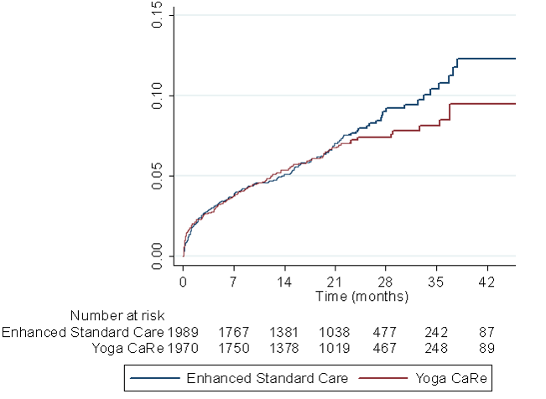
Primary Outcomes (ITT) - Kaplan Meir plot of Cardiovascular Events
HR[CI] = 0.91[0.72, 1.15]
Log rank test, p=0.41
Less than half the number of events as compared to the original assumption

Slide 12
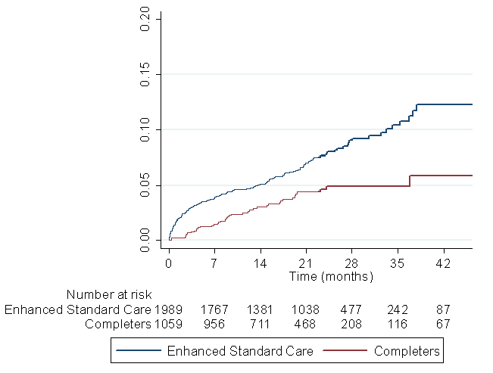
Primary Outcomes (Per-protocol): Kaplan Meir plot of Cardiovascular Events
HR[CI] = 0.54 [0.38, 0.76]
Log rank test, p<0.001
Completers = those who participated in ≥10 Yoga-CaRe sessions

Slide 13
Primary Outcome (ITT)
Co-Primary Outcome 2 | ESC (n=1989) Mean (CI) | YC (n=1970) Mean (CI) | Regression Coefficient, 95% CI (unadjusted) | p
Mean Change in EQ-5D VAS Score (from baseline to three months) | 9.2 (8.4, 10.1) | 10.7 (9.9, 11.5) | 1.4 (0.3, 2.5) | 0.002
Coefficient remained significant after adjusting for baseline covariates, risk profiles and treatments at discharge
“Improvement in the Self-rated quality of life was significantly greater in the Yoga-CaRe group”

Slide 14
Secondary outcomes: ITT Analysis
Outcomes at three months | Unadjusted Regression coefficient (CI) | p-Value
Change in health states - EQ-5D | -0.03 (-0.19, 0.13) | 0.72
Return to Pre-infarct daily activities | 1.17 (0.11, 2.23) | <0.001
Outcomes at three months | Unadjusted Odds Ratio (CI) | p-Value
Health states (<6) | 1.16 (1.01, 1.34) | 0.04
Tobacco cessation | 1.14 (0.89, 1.46) | 0.11
High compliance to medication | 1.04 (0.91, 1.19) | 0.52

Slide 15
Conclusions
Yoga-CaRe, a yoga based CR, is safe, feasible and significantly improves quality of life and return to pre-infarct daily activities.
The clinical outcomes were not different between the two groups (Inadequate power to detect the planned difference due to lower event rate than estimated).
Per-protocol analysis showed Yoga-CaRe program to be efficacious in improving clinical outcomes suggesting a potential dose-response relationship.
Yoga-CaRe has the potential to be an alternative to the conventional CR programs and address the unmet needs of cardiac rehabilitation for patients in low- and middle-income countries.

Slide 16
Contributors
Dorairaj Prabhakaran (India) & Sanjay Kinra (UK) – Principal Investigators
Co-Investigators & Research Team
Ambuj Roy | Subash Chander Manchanda
Ajay Vamdevan | K Srinath Reddy
Nish Chaturvedi | Alun Hughes
Ian Roberts | Stuart Pocock
Shah Ebrahim | Chandrasekaran AM
Kalpana Singh | Kaushik Chattopadhyay
Kavita Singh | Divya Soni
Dimple Kondal | Praveen Pradeep
Raji Devarajan | Nikhil Tandon
Trial Steering Committee, Data Monitoring and Ethics Committee & Endpoint Adjudication Committee
Top Clinical Sites | Site-Investigators
DMC Ludhiana | Bishav Mohan
CH Pune & Bengaluru | Davinder Singh Chadha
IGMC Shimla | Sanjeev Asotra & PC Negi
SJICSR Bengaluru | Prabhavathi
SJICSR Mysuru | K Sadananda
JSS Hospital | Nagaraj Desai & Sunil Kumar
KPKH Belagavi | Prasad
SGRH New Delhi | Subash Chander Manchanda
LSSH Guntur | PV Ragahv Sarma
KGMU Lucknow | Sharad Chandra
BLDE Vijapura | Shankar Patil
CARE Hyderabad | Calambur Narasimhan
AIIMS New Delhi | Ambuj Roy
GKNM Coimbatore | S Natarajan
Acknowledgement:
Clinical site – Research Team Yoga-CaRe Instructors Trial Participants & families
Indian Council for Medical Research Medical Research Council

